Slide 1
FIN: The following slides describe
extra
Channel design based on open channel flow constraints
Scour velocity necessary to keep flocs moving

Slide 2
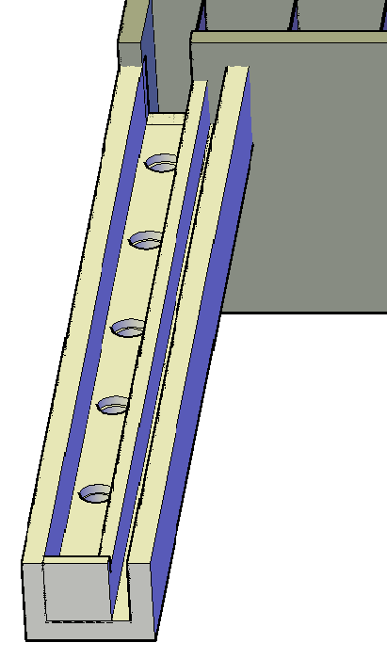
Flocculated water drain channel
extra
Used to dump flocculated water when treatment fails
Makes it possible to save the sedimentation tanks from being filled with poorly flocculated water and thus reduces the time required to bring the plant back on line after a treatment failure.
Need an algorithm to determine the width of this channel

Slide 3
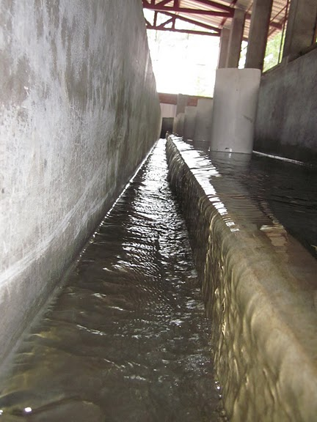
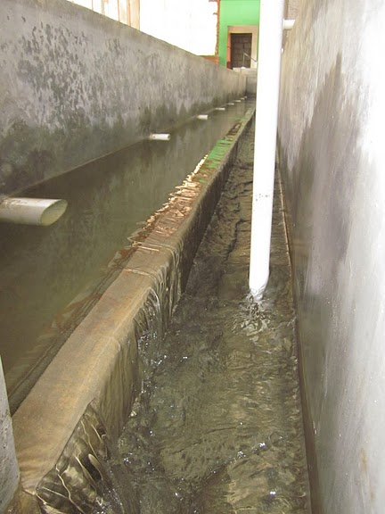
Channels with Weirs
extra
Flocculated Water Channel
Settled Water Channel

Slide 4
Open Channel Flow: Energy Relations
extra
velocity head
energy
______ grade line
hydraulic
_______ grade line
Bottom slope (S_{o}) not necessarily equal to EGL slope (S_{f})

Slide 5
Energy Relationships
extra
Pipe flow
z - measured from horizontal datum
From diagram on previous slide...
Turbulent flow (α ≅ 1)
y - depth of flow
Energy Equation for Open Channel Flow

Slide 6
Max flow in a short horizontal channel given a ΔH
extra
Energy Equation
V is zero at upstream end
Bottom slope is zero
Include wall shear
H is upstream depth
Use downstream velocity
Notes:
These functions require recursion because the friction factor and the hydraulic radius are both functions of the depth of water and the channel width.

Slide 7
Channel geometry given a target H/W ratio
extra
Iteration required because f is a function of Re.

Slide 8
Floc Scour Analysis: keeping flocs moving!
extra
“The velocity of flocculated water through conduits to settling basins shall not be less than 0.15 m/s nor greater than 0.45 m/s.”
“Allowances must be made to reduce turbulence at bends and changes in direction”
We need to develop a guideline that scales correctly and that takes into account the energy dissipation rate in the flocculator
Are these velocities a true constant?
http://10statesstandards.com/waterstandards.html#4.1.3
--Recommended Standards for Water Works

Slide 9
Floc transport on channel bottom
extra
The constraint is the need to be able to roll a floc along the bottom of the channel
Little flocs are easiest to drag along the bottom of a channel
Thus the constraint is the ability to roll big flocs

Slide 10
Basic Mechanism of Bed Load Sediment Transport
extra
drag force exerted by fluid flow on individual grains
retarding force exerted by the bed on grains at the interface
particle moves when resultant passes through (or above) point of support
V
h
In turbulent flow force of drag will vary with time
F_{d}
F_{g}
θ
Grains: usually we mean incoherent sands, gravels, and silt, but also sometimes we include cohesive soils (clays) that form larger particles (flocs)
point of support

Slide 11
Threshold of Movement
extra
Force on particle due to gravity
Force on particle due to fluid shear
We expect movement when
θ
The minimum shear required to roll a floc

Slide 12
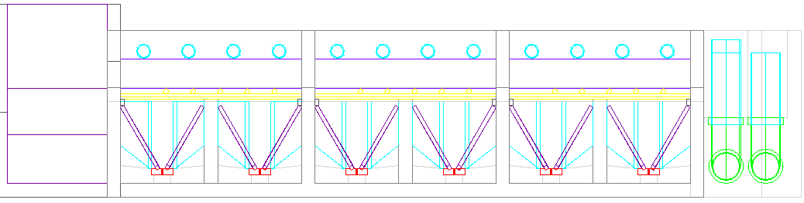
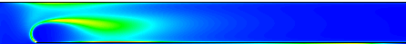
What is the shear acting on the Channel Bed?
extra
Hydraulic radius!
But, this analysis is for uniform flow!

Slide 13
Boundary Layer
extra
The channel is relatively short and thus the flow is non-uniform
Key concepts
Entrance region
Developing boundary layer
Bed (or wall) shear

Slide 14
Boundary Layer Transition to Turbulence
extra
V
V
V
δ
y
turbulent
V
x
Viscous
sublayer
This slope (du/dy) controls τ₀.
Where are flocs going to stop rolling?

Slide 15
Minimum Shear – Minimum Velocity
extra
Lowest shear will be where the boundary layer switches from laminar to turbulent (500,000)
Drag in laminar boundary layer
Distance along channel
The lowest velocity that will keep flocs moving

Slide 16
Are the Flocs (buried) in the Boundary Layer?
extra
YES!

Slide 17
Minimum Scour Velocity
extra
Fractal density

Slide 18
Shields Diagram (1936)
extra
1
Suspension
Saltation
0.1
0.056
No movement
Threshold of movement
0.01
1
10
100
1000
Turbulent flow of bed
Laminar flow of bed

Slide 19
Scour Velocity
extra
If we assume that the ten state standards are based on the ability to scour a large floc (5 mm) then the angle must be 4.8 degrees!
Design decision – should we consider 0.15 m/s as a design constraint or should we allow for lower velocities if we have smaller flocs due to higher energy dissipation rates?

Slide 20
Reflections on Scour Velocity
extra
The lower velocity limit proposed by the 10 State Standards is a reasonable guide for rolling large flocs. And the velocity IS independent of the scale of the plant (as long as the channel flow is turbulent).
But, the lower velocity limit doesn’t account for the ability to produce smaller flocs that are easier to roll along
What happens if the plant is operated at 50% of capacity? __________________________
(Shut down some sed tanks!)

Slide 21
Suppose we adopt the 0.15 m/s rule (ε_{Max} consequences)
extra
ε_{Max} produced at channel transitions is the same value as used for flocculator design.
Small plants will be a challenge!

Slide 22
Suppose we adopt the 0.15 m/s rule (d_{Floc} consequences)
extra
Will we be able to capture these flocs?
AguaClara Capture Velocity is 0.12 mm/s, so
Yes!
Based on alum flocs in a tube flocculator

Slide 23
Taking issue with the 10 State Standard (0.15 m/s)
extra
As we increase the velocity in the channel the energy dissipation rate increases
As the energy dissipation rate increases the floc size decreases
As the floc size decreases the velocity required to scour the flocs decreases

Slide 24
Relaxing the 10 State Standard…
extra

Slide 25
Channel Design Reflections Analysis Limitations
extra
Inlet Channel should be tapered to maintain scour velocities (first test of this at San Nicolas, Honduras)
The equations characterizing maximum energy dissipation rate are based on jet flow
The maximum floc size based on the energy dissipation rate is based on laminar flow tube flocculator data using alum as the coagulant

Slide 26
Minimum spacing for Grit chamber design (work in progress)
extra
But terminal velocity and floc diameter are related!
Length of grit plate settler

Slide 27

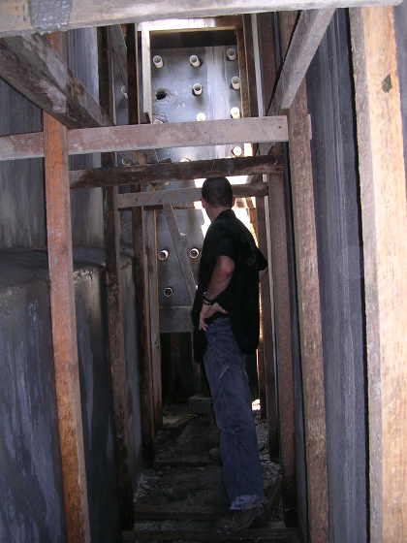
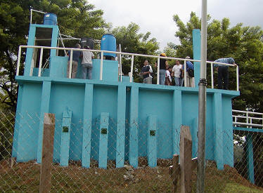
Conventional Horizontal Flow Sedimentation Basin
extra
long rectangular basins
4-6 hour retention time
3-4 m deep
max of 12 m wide
max of 48 m long
Ratio of surface area to cross sectional area must be less than 18
What is V_{c} for conventional design?
Settling zone
Outlet zone
Inlet zone
Sludge zone
Sludge out
Notes:
Ratio of surface area to cross sectional area must be less than 18. Water Quality and Treatment 5th edition page 7.30

Slide 28
Design Criteria for Horizontal Flow Sedimentation Tanks
extra
Settling zone
Outlet zone
Inlet zone
Sludge zone
_______________________________
_______________________________
_______________________________
_______________________________
_______________________________
V_{c} of 0.23 to 0.7 mm/s*
Residence time of 1.5 to 3 hours*
Minimal turbulence (inlet baffles)
Uniform velocity (small dimensions normal to velocity)
No scour of settled particles
Slow moving particle collection system
Q/A_{s} must be small (to capture small particles)
* Surface Water Treatment for Communities in Developing Countries. Christopher R. Schulz,Daniel A. Okun

Slide 29
Turbulence in Horizontal Flow Sedimentation Tanks
extra
Question: If the flow through a sedimentation tank turbulent and if it is, is vertical transport by turbulent eddies significant?
Given
Ratio of surface area (width*length) to cross sectional area (width*depth) must be less than 18 (length/depth < 18)
V_{c} of 0.23 mm/s (use conservative design)
Notes:
Ratio of surface area to cross sectional area must be less than 18. Water Quality and Treatment 5th edition page 7.30

Slide 30
Turbulence in Horizontal Flow Sedimentation Tanks
extra
What is the horizontal flow velocity (V_{H})?
V_{c}*Width*Length=V_{H}*Width*Depth
V_{H} = 18*V_{c} = 4.2 mm/s
Re Therefore turbulent
Turbulent eddies often have velocities that are order 10% of the mean velocity – 0.42 mm/s. This is higher than V_{c} and thus the high horizontal velocity could prevent flocs from settling
Notes:
Ratio of surface area to cross sectional area must be less than 18. Water Quality and Treatment 5th edition page 7.30

Slide 31
Problems with Horizontal Flow Tanks
extra
Perform 3 times worse than laboratory sedimentation tanks*
Are incompatible with floc blanket
Generate eddies that prevent flocs from settling if the horizontal velocities are too high
Cause preferential flow through plate settlers at the end of the tank (where the horizontal velocities decrease and the pressure below the plates increases)
AguaClara uses vertical flow sedimentation tanks
*Surface Water Treatment for Communities in Developing Countries. Christopher R. Schulz,Daniel A. Okun. page 140
Notes:
*Schulz and Okun page 140

Slide 32
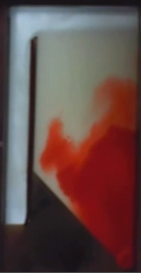
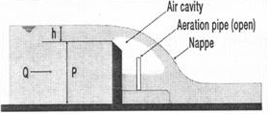
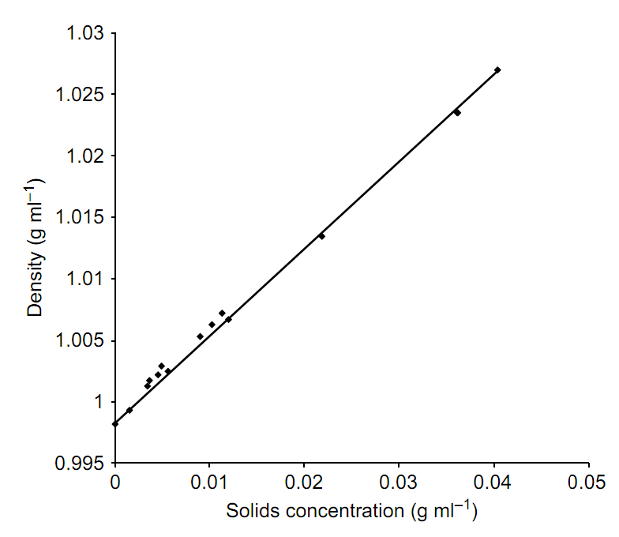

How deep is the flow over the floc weir?
extra
Depth of floc suspension flowing over weir
Notes:
http://www.iwaponline.com/jws/059
Journal of Water Supply: Research and Technology—AQUA Vol 59 No 5 pp 312–323 © IWA Publishing 2010 doi:10.2166/aqua.2010.046
Parameters affecting steady-state floc blanket performance
Matt Hurst, Monroe Weber-Shirk and Leonard W. Lion
School of Civil and Environmental Engineering, Cornell University, Hollister Hall, Ithaca NY 14853-3501, USA Tel.: +1 607 255-8445 Fax: +1 607 255-9004 E-mail: mw24@cornell.edu/0312/0590312.pdf
http://youtu.be/3TjgNe2SidQ

Slide 33
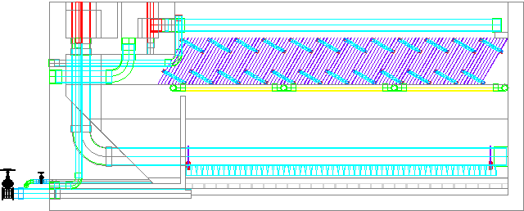
How deep is the flow over the floc weir?
extra
*
We need lab and field measurements to confirm this!
For 500 NTU and a 3 m long sed tank the depth is 18 cm.
This suggests that a longer weir will be needed for longer sed tanks
*Based on measurements with kaolin clay (turbidimeter team Spring 2011)
Notes:
Floc weir design.xmcd

Slide 34
Floc consolidation (dewatering)*
extra
*Edge of knowledge alert! We need a model!
Water released from the flocs will flow back out of the floc hopper and into the plate settlers
The sedimentation velocity of the flocs is initially the same as in the floc blanket (1 mm/s)
500 NTU = 0.85 g/L therefore floc hopper is 42% of sed?

Slide 35
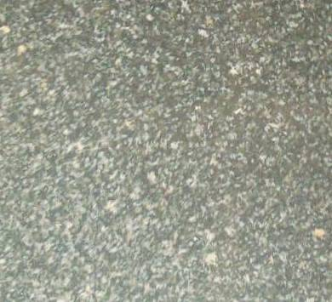

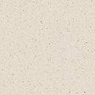
Mass Balance in Sed Tank
extra
Flocculator
Floc blanket
Floc hopper
Q_{FlocBlanket}
Q_{Influent} - Q_{Sludge}
C_{FlocBlanket}
Q_{Return}
Q_{Influent}
Inlet Manifold
C_{Influent}
Q_{Sludge}
C_{sludge} = 125g/L
Notes:
Floc hopper concentration based on mass conservation and rise rate in Casey’s apparatus
24 min flocculator - 109 gm/L
3 min flocculator - 143 gm/L
0.39 flocculator - 135 gm/L (this is only one experiment though)

Slide 36
Reynolds Number in Plate Settlers
extra
Re is laminar for typical designs
Reducing S reduces Re further

Slide 37
Entrance Region Length
extra
The distance required to produce a velocity profile that then remains unchanged
Laminar flow velocity profile is parabolic
Velocity profile begins as uniform flow
Are tube and plate settlers long enough to get to the parabolic velocity profile?
α

Slide 38
Entrance Region Length for Tube
extra
Distance for velocity profile to develop
Shear in the entrance region is _______ than shear in long pipes for laminar flow.
higher
laminar
turbulent

Slide 39
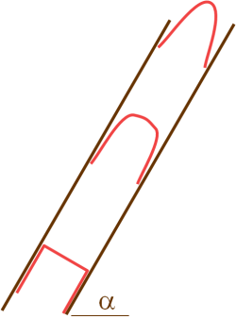
Entrance Length Region for AguaClara Designs
extra
*
Entrance length is shorter than plates
*This equation applies to tubes. The coefficient may need to be changed to apply it to plates.
Notes:
It is possible that the S in the equation for Le should be replaced with 4*(hydraulic radius) or 2S. That would significantly increase the length of the entrance region. But I am inclined to think that the current analysis is correct. The ratio of wetted perimeter to area should be the important parameter in setting up the velocity profile and we have already accounted for that in the Re. I don’t think it would be correct to account for this change in both the Re and in the entrance length relationship.

